Slide 1
Defend&Publish
Ep 60 Tips for Edited Collections – Pt. 1 Getting Started

Slide 2
1. Develop a clear call and distribute appopriately
What is the purpose of your edited collection?
What is the working title for this project?
Where do you plan to submit it (press, series, backups)? What must go in the call that will meet the needs of this audience?
How do you think your collection will be used and by who?
What is the timeline for entire project (proposal review, first drafts due, etc.)?
Whrere can this call be circulated?
Can authors be invited?

Slide 3
2. Get a proposal first
Ask for 150-250 word chapter proposals to review who might fit in the collection and where
Organize proposals into yes, no, maybe and brainstorm sections or working table of contents

Slide 4
3. Develop clear submission guidelines for those accepted and communicate next steps
What documentation style?
Length of chapters?
Single or double spaced, font, and size?
Other style guidance?
Rules for figures, tables, and images?
Deadlines and how to submit?

Slide 5
4. Design a workflow
Where are first drafts stored, second drafts, etc.? (Google Docs? Asana?)
Where are notes stored for all chapters?
How are emails with contributors tracked?
How is email communication with contirbutors systematized?

Slide 6
5. Break project into parts
Foreword and Afterword – invite someone?
Design table of contents based on chapters submitted and note holes (invite additional authors?)
Organize chapters into sections
Decide on focus for introductory chapter and concluding chapter
Determine if other editorial material is needed (section introductions, etc.)
Select focus for supplimentary material (teaching unit, website, etc.)

Slide 7
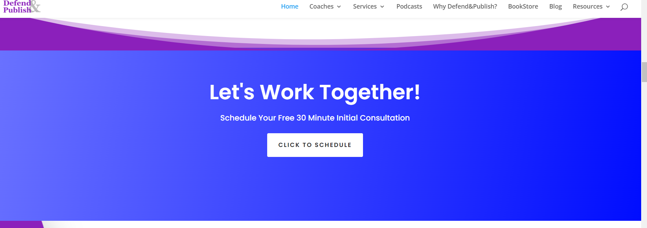
Brainstorm ideas for your collection with us!

